Slide 1
CSSE3113 – Introduction to Software Engineering
Understanding Requirements

Slide 2
Requirements
IEEE Standard 729 defines it as
“A condition or capability needed by a user to solve a problem or achieve an objective”
“A condition or capability that must be met or possessed by a system...to satisfy a contract, standard, specification, or other formally imposed document”

Slide 3
Requirement Engineering
Many software developers want to jump right in building software before they have a clear understanding of what is needed.
They argue that things will become clear as they build, that project stakeholders will be able to understand need only after examining early iterations of the software, that things change so rapidly that any attempt to understand requirements in detail is a waste of time.
The bottom line is producing a working program and all else is secondary.
What makes these arguments seductive is that they contain elements of truth. But each is flawed and can lead to a failed software project.
The broad spectrum of tasks and techniques that lead to an understanding of requirements is called requirements engineering.
It beings with communication activity and continues into the modeling activity. It builds a bridge to design and construction.

Slide 4
Software Requirements and Requirement Engineering
The requirements for a system
are the descriptions of the services provided by the system and its operational constraints.
These requirements reflect the
needs of customers for a system that helps solve some problems such as controlling a device, placing an order or finding information.
“The process of finding out, analysing, documenting and checking these services and constraints is called requirements engineering (RE).”

Slide 5
Different Levels Of Abstraction
User requirements
are statements, in a natural language plus diagrams, of what services the system is expected to provide and the constraints under which it must operate. The user requirements may vary from broad statements of the system features required to detailed, precise descriptions of the system functionality.
System requirements
System requirements set out the system’s functions, services and operational constraints in detail.
The system requirements document (sometimes called a functional specification) should be defined exactly what is to be implemented.
It may be part of the contract between the system buyer and the software developers.

Slide 6
Example 1
User requirement: The library system should provide a way to allow a student to borrow a book from the library.
System requirement: The library system should provide a withdraw interaction that allows a student to withdraw a book given the isbn and copy number of the book to be withdrawn.
The interaction fails if: the book is already withdrawn, the book is not in the library's collection, the student has already withdrawn 5 books, the student owes more than $5, the book is on hold by someone else. Otherwise…(To be completed)

Slide 7
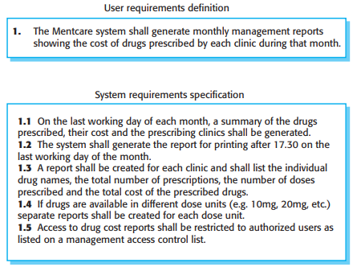
Example 2

Slide 8
Requirements for Different Stakeholders
You need to write requirements at different levels of detail because different types of readers use them in different ways.
The readers of the user requirements are not usually concerned with how the system will be implemented
Managers are not interested in the detailed facilities of the system.
The readers of the system requirements need to know more precisely what the system will do.
They are concerned with how it will support the business processes or because they are involved in the system implementation.

Slide 9
Requirements for Different Stakeholders
The different types of document readers are actually the system stakeholders.
System stakeholders include anyone who is affected by the system in some way and so anyone who has a legitimate interest in it.
Stakeholders range from end-users of a system through managers to external stakeholders such as regulators, who certify the acceptability of the system.

Slide 10
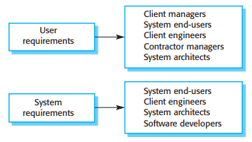
Requirements for Different Stakeholders

Slide 11
Requirements for Different Stakeholders
For example, system stakeholders for the Mentcare system include:
Patients whose information is recorded in the system and relatives of these patients.
Doctors who are responsible for assessing and treating patients.
Nurses who coordinate the consultations with doctors and administer some treatments.
Medical receptionists who manage patients’ appointments.
IT staff who are responsible for installing and maintaining the system.
A medical ethics manager who must ensure that the system meets current ethical guidelines for patient care.
Health care managers who obtain management information from the system.
Medical records staff who are responsible for ensuring that system information can be maintained and preserved, and that record keeping procedures have been properly implemented.

Slide 12
Types Of Requirements
Software system requirements are often classified as
Functional requirements
Non-functional requirements

Slide 13
Functional Requirements
These are statements of services the system should provide.
They bring in the system’s view and define from the system’s perspective
Services the system should provide
How the system should react to particular input
How the system should behave in a particular situations
or
What the system should not do

Slide 14
Functional Requirements
Functional requirements for the Mentcare system, used to maintain information about patients receiving treatment for mental health problems:
A user shall be able to search the appointments lists for all clinics.
The system shall generate each day, for each clinic, a list of patients who are expected to attend appointments that day.
Each staff member using the system shall be uniquely identified by his or her eight-digit employee number.

Slide 15
Requirements Completeness and Consistency
Completeness means that all services and information required by the user should be defined.
Consistency means that requirements should not be contradictory.
In practice, it is only possible to achieve requirements consistency and completeness for very small software systems.
One reason is that it is easy to make mistakes and omissions when writing specifications for large, complex systems.
Second reason is that large systems have many stakeholders, with different backgrounds and expectations.
Inconsistent requirements may only be discovered after deeper analysis or during system development.

Slide 16
Non-functional Requirements (NFR’s)
These are constraints on the services or functions offered by the system.
They include timing constraints, constraints on the development process and constraints imposed by standards.
Non-functional requirements often apply to the system as a whole. They do not usually just apply to individual system features or services.

Slide 17
Types of NFR’s

Slide 18
Types of NFR’s (Contd..)
Product requirements
Requirements which specify that the delivered product must behave in a particular way.
e.g. execution speed, reliability, Usability, etc.
Organizational requirements
Requirements which are a consequence of organizational policies and procedures in the customer’s and developer's organization.
External requirements
Requirements which arise from factors which are external to the system and its development process
e.g. legislative requirements, etc.

Slide 19
Types of NFR’s (Contd..)
Reliability Requirements:
Reliability requirements deal with the failure to provide service.
Example :
The failure frequency of a heart-monitoring unit that will operate in a hospital’s intensive care ward is required to be less than one in 20 years. Its heart attack detection function is required to have a failure rate of less than one per million cases.

Slide 20
Types of NFR’s (Contd..)
Efficiency Requirements:
Deals with the hardware resources needed to perform the functions of the software.
The main hardware resources to be considered are the computer’s
processing capabilities (measured in MIPS – million instructions per second, MHz or megahertz etc.), its data storage capability in terms of memory and disk capacity (measured in MBs – megabytes, GBs – gigabytes, etc.) and the data communication capability of the communication lines (usually measured in KBPS – kilobits per second., etc)
The requirements may include the maximum values at which the hardware resources will be applied in the developed software system

Slide 21
Types of NFR’s (Contd..)
Portability Requirements:
Portability requirements tend to the adaptation of a software system to other environments consisting of different hardware, different operating systems, and so forth.
Interoperability Requirements:
Interoperability describes the extent to which systems and devices can exchange data, and interpret that shared data.
For two systems to be interoperable, they must be able to exchange data and present that data such that it can be understood by a user

Slide 22
Types of NFR’s (Contd..)
Integrity – deal with system security that prevent unauthorized persons access.
Usability – deals with the scope of staff resources needed to train new employees and to operate the software system.

Slide 23
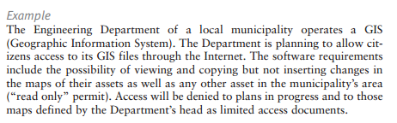
Integrity

Slide 24
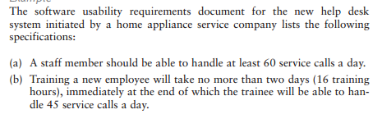
Usability

Slide 25
Example: A Word Processor
Let us now look at an example to understand the difference between these different types of requirements.
Let us assume that we have a word-processing system that does not have a spell checker. In order to be able to sell the product, it is determined that it must have a spell checker

Slide 26
Contd..
The User Requirement could be as follows:
Finding spelling errors in the document and deciding whether to replace each misspelled word with one chosen from a list of suggested words. It is important to note that this requirement is written from a user’s perspective.
After documenting the user’s perspective in the form of user requirements, we look at the system’s perspective:
what is the functionality provided by the system and how will it help the user to accomplish these tasks.

Slide 27
Contd..
The functional requirement for the same user requirement could be written as follows:
The spell checker will find and highlight misspelled words.
It will then display a dialog box with suggested replacements.
The user will be allowed to select from the list of suggested replacements.
Upon selection it will replace the misspelled word with the selected word.
Finally, a non-functional requirement of the system could require that it must be integrated into the existing word-processor that runs on windows platform

Slide 28
Specifying the Requirements
Functional and nonfunctional requirements should be specified in such a way that they are understandable by system users who don’t have detailed technical knowledge.
These requirements are defined using natural language, tables and diagrams as these can be understood by all users.

Slide 29
Guidelines
While specifying or writing the requirements, following guidelines must be followed:
Invent a standard format and use it for all requirements.
Use language in a consistent way.
Avoid the use of computer jargons.
Separate functional and non-functional requirements.
Distinguish requirements priorities
Example: MoSCoW (Must, Shall, Could, Want/Will (no TBD))
Testable (write test cases)

Slide 30
Example – Identify the problem
If sales for current month are below target sales, then report is to be printed unless difference between target sales and actual sales is less than half of difference between target sales and actual sales in previous month, or if difference between target sales and actual sales for the current month is less than 5%.

Slide 31
Contd..
Problems:
Difficult to read
Ambiguity: sales and actual sales, 5% of what?
Incomplete: what if sales are above target sales?

Slide 32
Task
Write plausible system requirements for the following functions:
An unattended petrol (gas) pump system that includes a credit card reader. The customer swipes the card through the reader, then specifies the amount of fuel required. The fuel is delivered and the customer’s account debited.

